Slide 1
Data-a-Scientist Captsone
Yaqoub al qaoud
Cohort may 7th, 2019

Slide 2
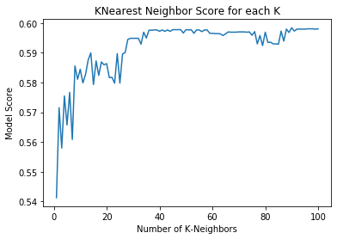
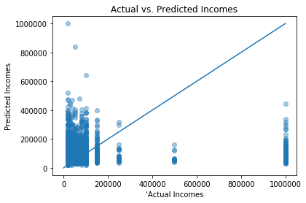
Question 1: Can we predict sex with education level and income?
- K-Nearest Neighbor Model
- Support Vector Model
Question 2: Can we predict income with length of essays and average word length?
- K-Nearest Neighbor Regressor Model

Slide 3
General Thoughts
I compared the original df row count vs the count if we would get rid of all null values. Removing nulls will result in a huge drop in our data size, which will definitely affect the quality of our Models' predictions.
This issue creates numerous scenarios in which we can take the next step of our project, that is creating the Models. For example, one way is to replace null values of certain columns that we think could most likely be equivalent to Zero. However, I thought this could mean that we are being bias or manipulative to the nature of the data.
I can go on and criticize every possible scenario here, but I think the optimal way to go forward with this project is to create different data frames for each model we are building, and dropping the null values of the columns that are needed for that specific model only. This will limit the number of rows we will sacrifice compared to dropping all nulls from the whole data frame at once, which will leave us with 7,127 rows only (from almost 60,000)!
Our first model will be built to answer the question: Can we predict sex with education level and income?? We can drop nulls here, for example, for only the sex, education level and income columns, leaving us with maximum rows to work with without manipulating the nature of the data. Using this method, we will also not drop rows that has sufficient answers for the sex, education, and income columns.
Later on I found out that almost 90% of the income column is equal to (-1)… which made it really hard to answer any of the questions as that is almost the whole data down the drain, even if we normalize ☺

Slide 4
Question 1: Can we predict sex with education level and income?
K-Nearest Neighbor
Model:
Most logical test compared to other questions in the instructions.
K-Nearest Neighbor Model Scores: Accuary 0.60 | Recall 0.23 | Precision 0.53
I did 100 iterations to find optimal K value as shown in the graph, and as we can see its at 45 to late 60s before it dips a little in the 70s, reaching optimal score at 60%. That is not a very good score, but it definitely is better than random guessing. I would say the issue is with the selected features.
SVC Model:
Very similar results to KNN model.
I was going for Gamma and C iteration to see if I can optimize it better, but it made it really slow and could not process even in 20 minutes. There weren’t any error popping up, just computing time was aweful.
SVC Model Scores: Accuary 0.59 | Recall 0.00 | Precision 0.00
Recall and Percision were not available due to TP/TP+FP issue.

Slide 5
Question 2: Can we predict income with length of essays and average word length?
Income, our dependent variable, had almost zero correlation with essays length and average word length in the dataset ☺
Regressions were definitely faster to run compared to classifications.
Unfortunately, I think my models did not do so well because of the “Income” column, which is basically corrupting the whole dataset.
Honestly, I expected cleaner data, or at least cleanable data, for this course. Also, the whole capstone instructions are kind of all over the place!
I commented on the code as you can see as I kept working on the project.

